Slide 1
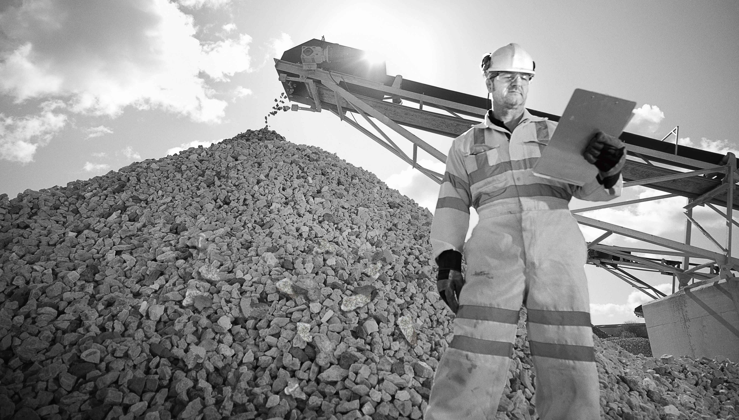


G-C Safety Protocol
Helmet Status: OK
MBD 2019 - A1 - Group C
Moutaz Al-Huneidi | Jan Marek Blaszczuk | Juan David Botero | Ekaterina Chunosova Rosalía Contreras | Juan Pablo Larrondo | Utkarsh Khemka
AI helmet recognition solution that ensures safety in the mines

Slide 2

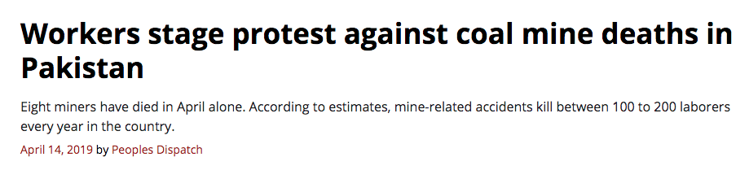
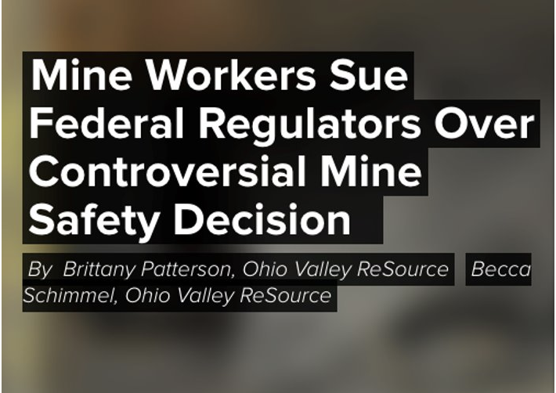
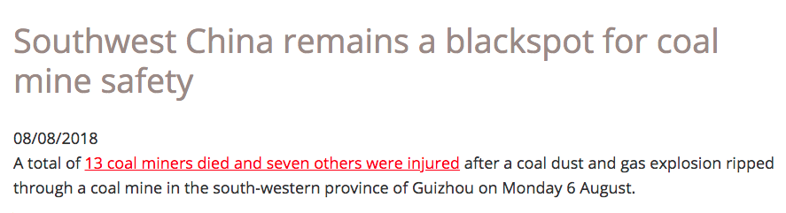
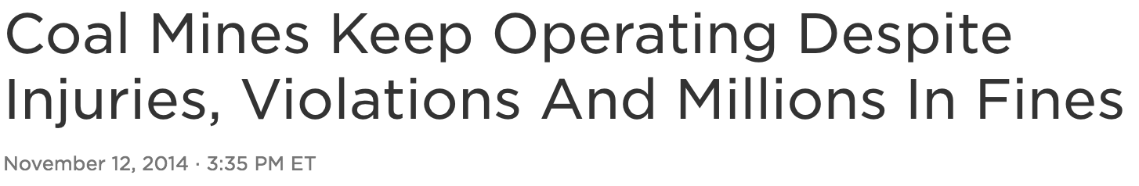
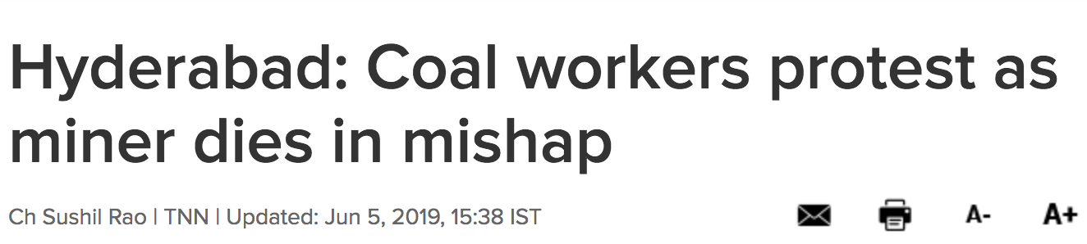




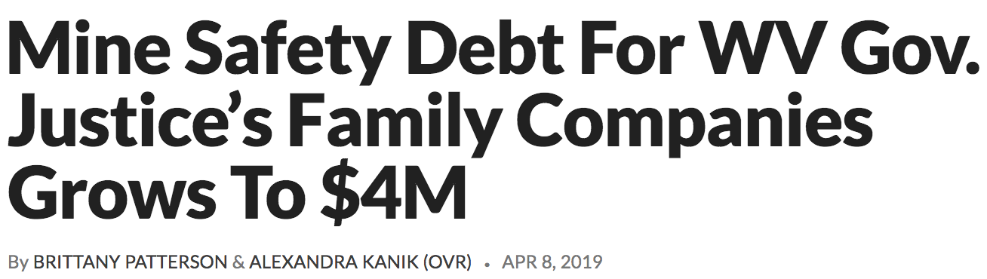
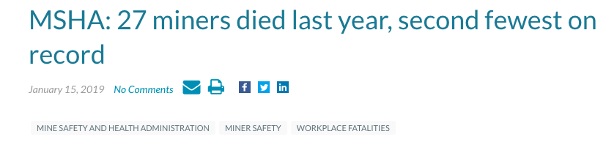
(un)Safe Conduct
Source: Footnote
Notes:
https://peoplesdispatch.org/2019/04/14/workers-stage-protest-against-coal-mine-deaths-in-pakistan/
https://www.safetyandhealthmagazine.com/articles/17925-msha-27-miners-died-last-year-second-fewest-on-record
https://clb.org.hk/content/southwest-china-remains-blackspot-coal-mine-safety
https://wfpl.org/mine-workers-sue-federal-regulators-over-controversial-mine-safety-decision/
https://www.npr.org/2019/04/10/711361672/governor-and-his-family-owe-millions-in-mining-violations-despite-promises-to-pa?t=1559739322874
http://www.orissapost.com/protest-over-guards-death-hits-mining-operations/
https://www.wkms.org/post/mine-safety-debt-wv-gov-justice-s-family-companies-grows-4m#stream/0
https://www.npr.org/2014/11/12/363058646/coal-mines-keep-operating-despite-injuries-violations-and-millions-in-fines?t=1559743593123
https://timesofindia.indiatimes.com/city/hyderabad/hyderabad-coal-workers-protest-as-miner-dies-in-mishap/articleshow/69664734.cms

Slide 3


Playing It (un)Safe
Fatalities Rate
Number of fatalities in mining industry by accident type, 2000-2016, Chile
Fatalities rate every 1M worked hours
0,50
N° of deaths
0,45
0,40
0,35
0,30
0,25
86
0,20
40
0,15
0,10
0,05
Hit by a rock
Fall from heights
Car falls
Crushed, smashed
Hit by others
Explosives
Electrocution
Gas Intoxication
Sucked
Burns
Immersion
Hit by explosive wave
Covered by material
Hypothermia
0,00
1994
1995
1996
1997
1998
1999
2000
2001
2002
2003
2004
2005
2006
2007
2008
2009
2010
2011
2012
2013
2014
2015
2016
2017
2018
Safety efforts are giving results, but over past years the fatality rates have reached their plateau. We need to find new ways to approach the problem and continue on the right track.
Source: Footnote
Notes:
http://sitiohistorico.sernageomin.cl/pdf/mineria/estadisticas/accidentabilidad_Minera/BalanceNacionaldeAccidentabilidadMinerade2016.pdf

Slide 4
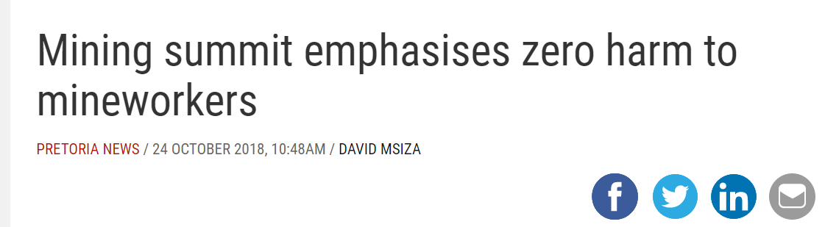
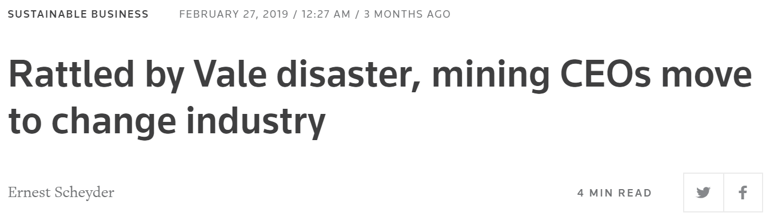
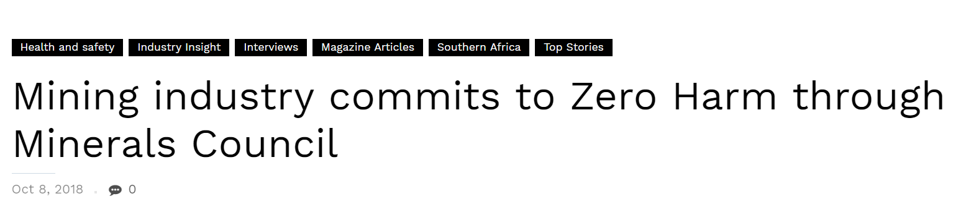
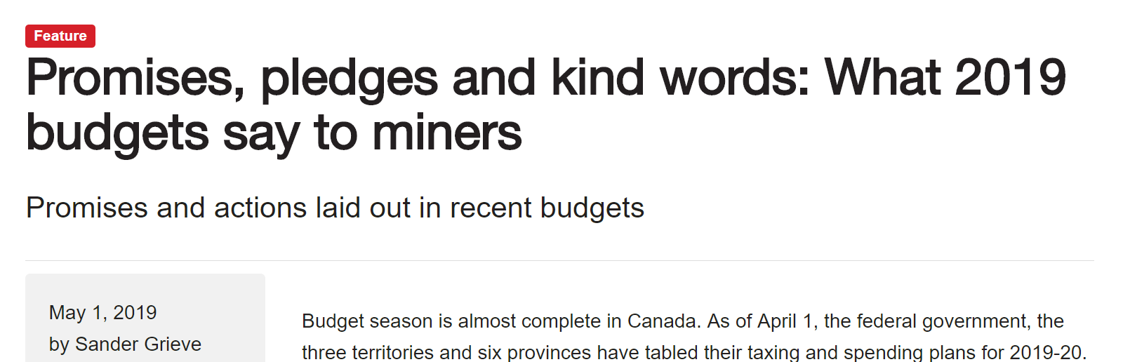
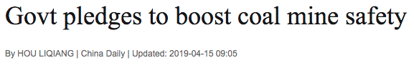
A Sa(f)ing Grace
Source: Footnote
Notes:
ttp://www.canadianminingjournal.com/features/promises-pledges-and-kind-words-what-2019-budgets-say-to-miners/
https://www.iol.co.za/pretoria-news/mining-summit-emphasises-zero-harm-to-mineworkers-17615767
http://www.chinadaily.com.cn/a/201904/15/WS5cb3d8efa3104842260b6275.html
https://www.reuters.com/article/us-mining-conference-executives/rattled-by-vale-disaster-mining-ceos-move-to-change-industry-idUSKCN1QF2YV
https://www.miningreview.com/top-stories/zero-harm-minerals-council/

Slide 5
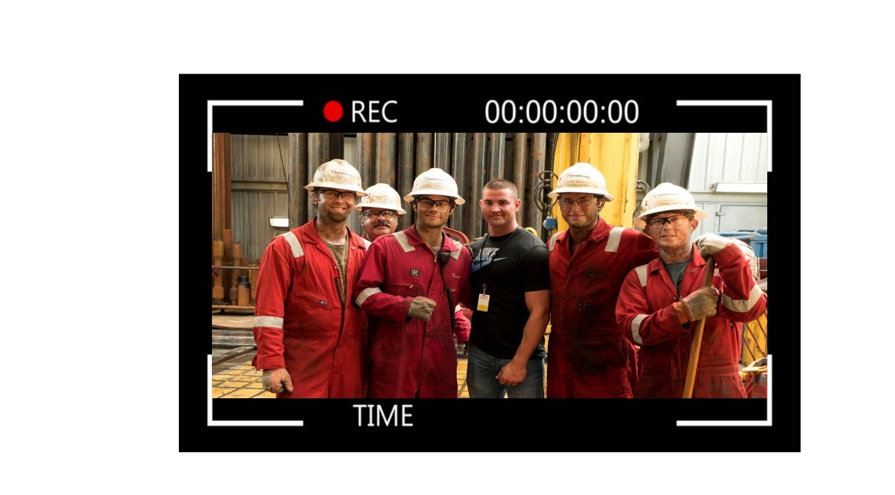



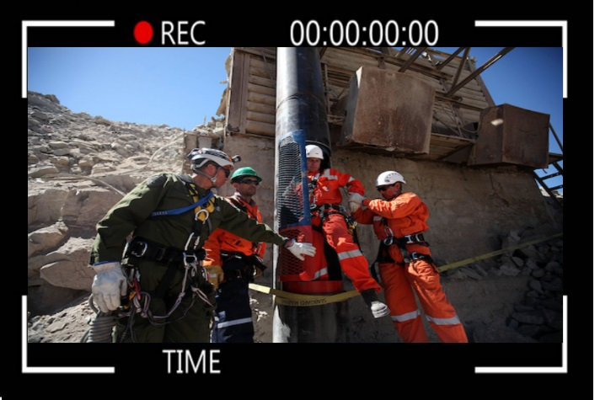
A Fail Safe Solution

Slide 6



The Safeguard
Uses existing on-site CCTV cameras
Alert will be raised when non-compliance is detected
The supervisor can follow-up remotely
Model accounts for people wearing hats or caps, people with peculiar hairstyles, low ambience environments for close-pit sites

Slide 7










The Money Safe
Subscription Fee
The Business Model
Hosting Costs
Governing Bodies
One-Time Licencing Fee
Image Processing Costs
On-Site Cameras
Processing Center
Company Offices
GC
Team and OH Costs
Subscription Fee

Slide 8

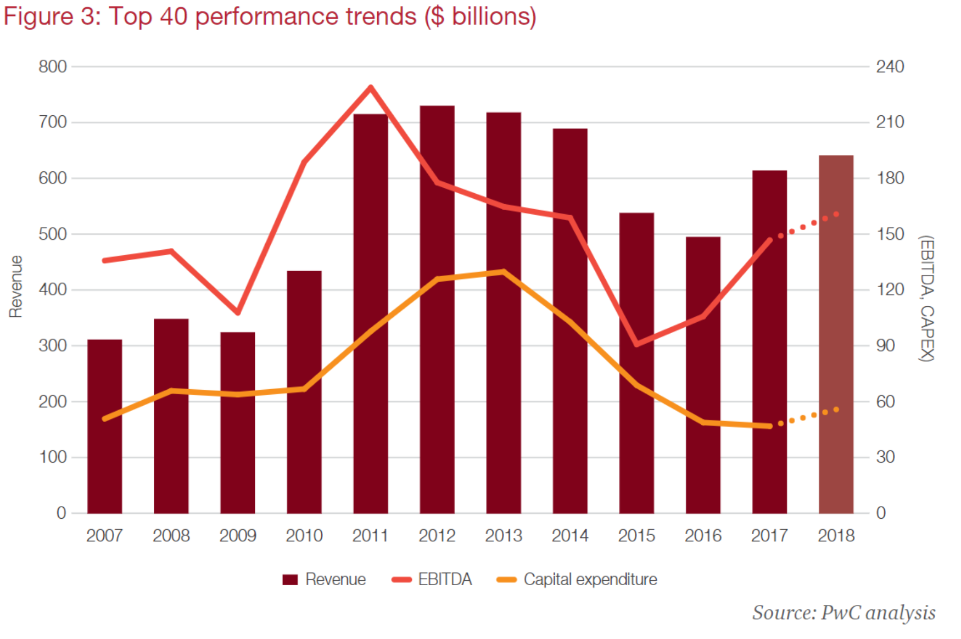

A Safe Bet
Market Size
Top 40 Performance ($ Billion)
Copper Yearly Operational Spend
MSHA 2019 Budget
Copper Yearly Operational Spend
$BUSD
Safety Spend
36,0
Operational Costs
1,8
34,2
12,0
$376M
0,6
2,4
11,4
> $600B
2,3
0,1
Escondida
Chile
World
$1.8B

Slide 9



Safety Gear
Safe Markets
Construction
Traffic regulation
Manufacturing

Slide 10
